Slide 1
Minor Project Presentation
Team Members:
Mahir Bansal (20124057) Mayank Gera (20124061) Naman Sharma (20124066) Sakshi Warandani (20124088)

Slide 2

Dr. Intelligent
Aim: Disease Prediction using Machine Learning
Concept: Machine Learning (ML) is essential in several areas, such as healthcare and medical data protection. ML is applied to analyze medical records and disease forecasts.
In our study, we review several ML algorithms, applications, techniques, opportunities, and challenges for the healthcare sector.
KNN is used in the prediction of the disease which is a supervised machine learning algorithm that is non-parametric and uses proximity to make classifications or predictions about the grouping of an individual data point.

Slide 3
Description
In this digital world, most of the people are prone to diseases, due to lack of healthy food, proper sleep and daily exercise. It is very crucial to know if we are suffering from a disease, at an early stage rather than discovering it at a later stage.
Utility: Most of the chronic diseases are predicted by our system. It accepts the structured type of data as input to the machine learning model. In our system, the user will enter all the symptoms from which he or she is suffering. These symptoms then will be given to the machine learning model to predict the disease to the best possible accuracy.
Methodology: For classification, the KNN algorithm is used, Logistic regression is used for extracting features which are having most impact value, and the Decision tree is used to divide the big dataset into smaller parts. The final output of this system will be the disease predicted by the model.

Slide 4
Algorithm used:
The K-NN working can be explained on the basis of the below algorithm:
Step-1: Select the number K of the neighbors
Step-2: Calculate the Euclidean distance of K number of neighbors
Step-3: Take the K nearest neighbors as per the calculated Euclidean distance.
Step-4: Among these k neighbors, count the number of the data points in each category.
Step-5: Assign the new data points to that category for which the number of neighbor is maximum.
Step-6: Our model is ready.

Slide 5
Website & APP

Slide 6


Slide 7
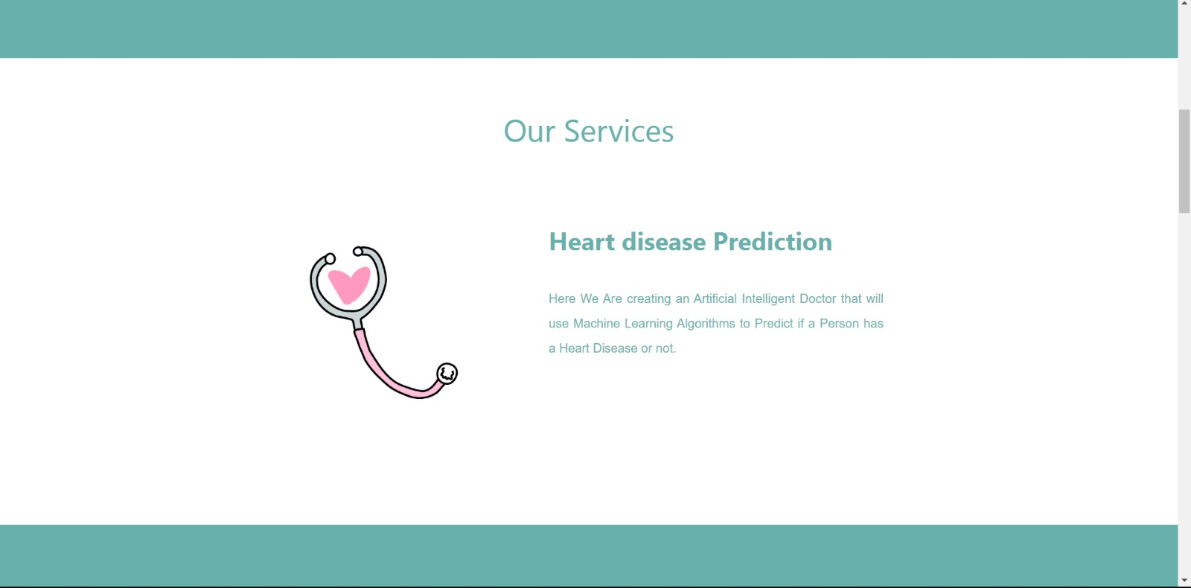

Slide 8


Slide 9
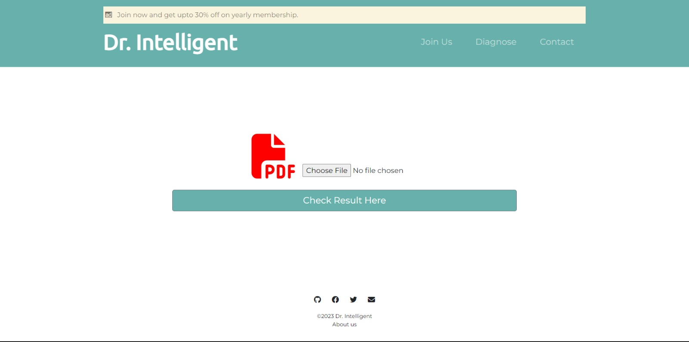

Slide 10
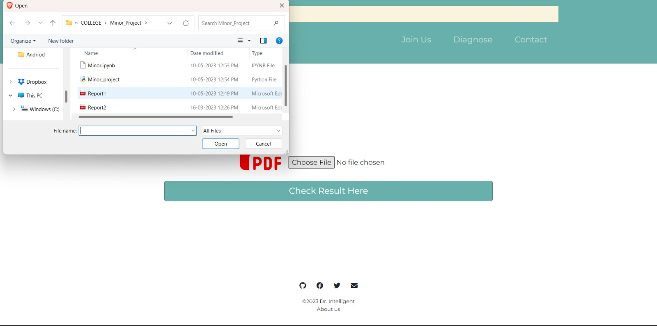

Slide 11
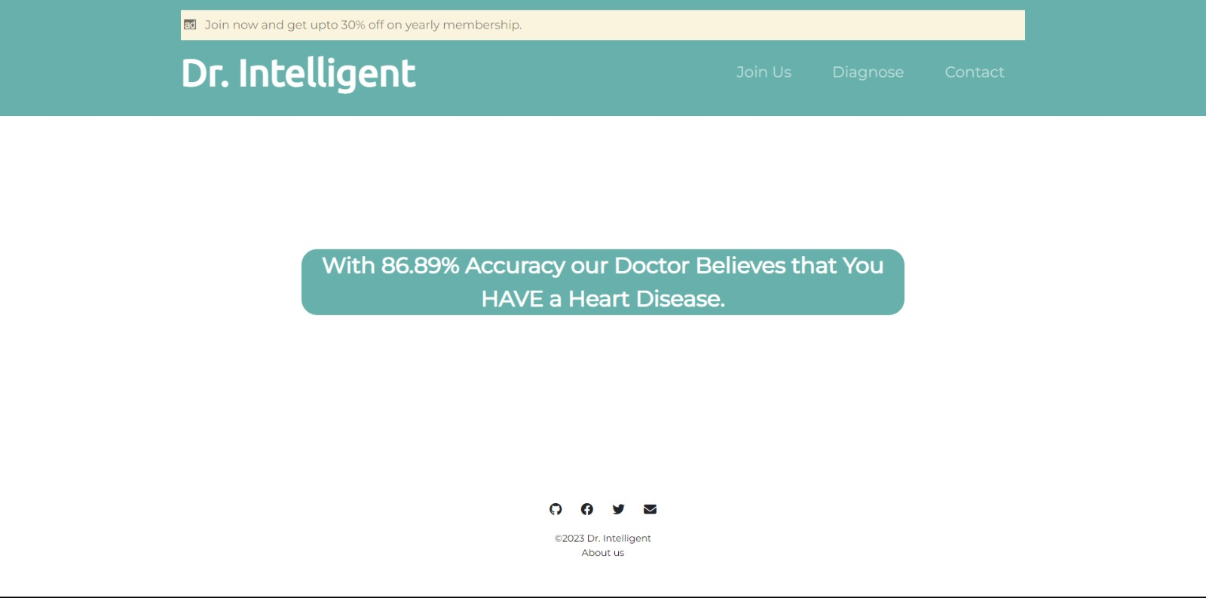

Slide 12


Slide 13

APP:

Slide 14
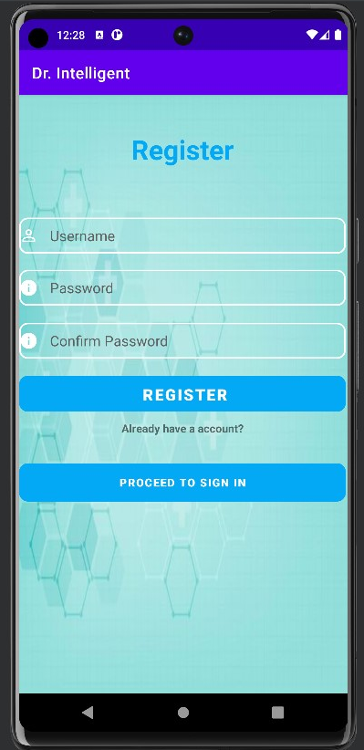
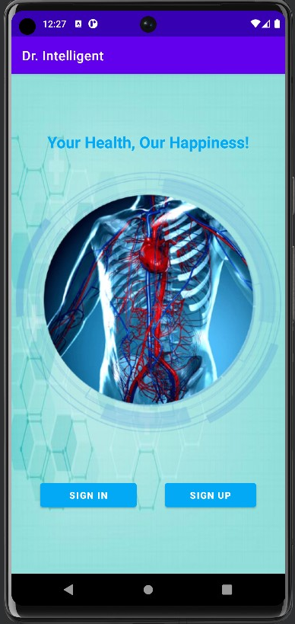
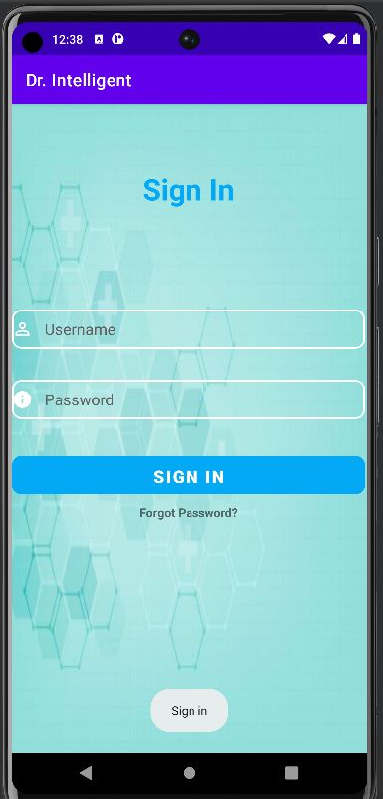

Slide 15
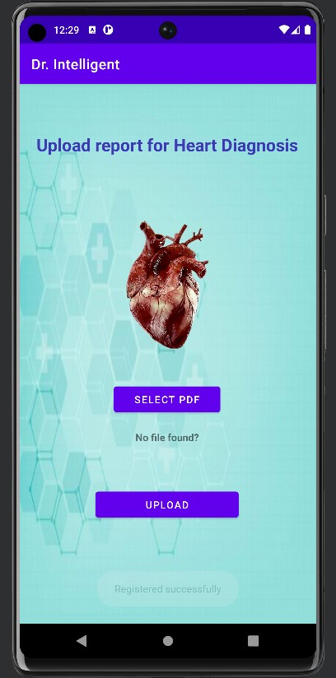
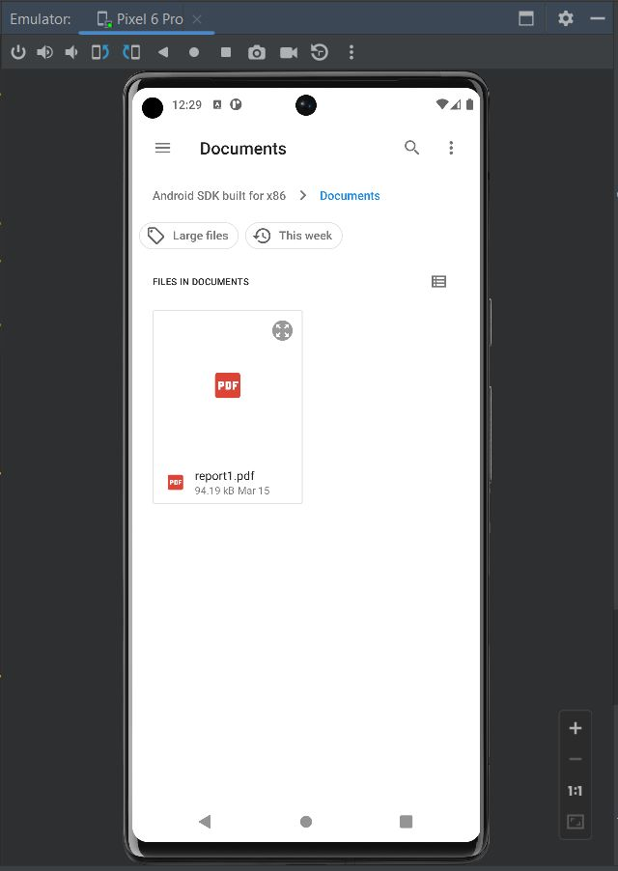

Slide 16
Result Same as Website

Slide 17
Thank you

